Slide 1
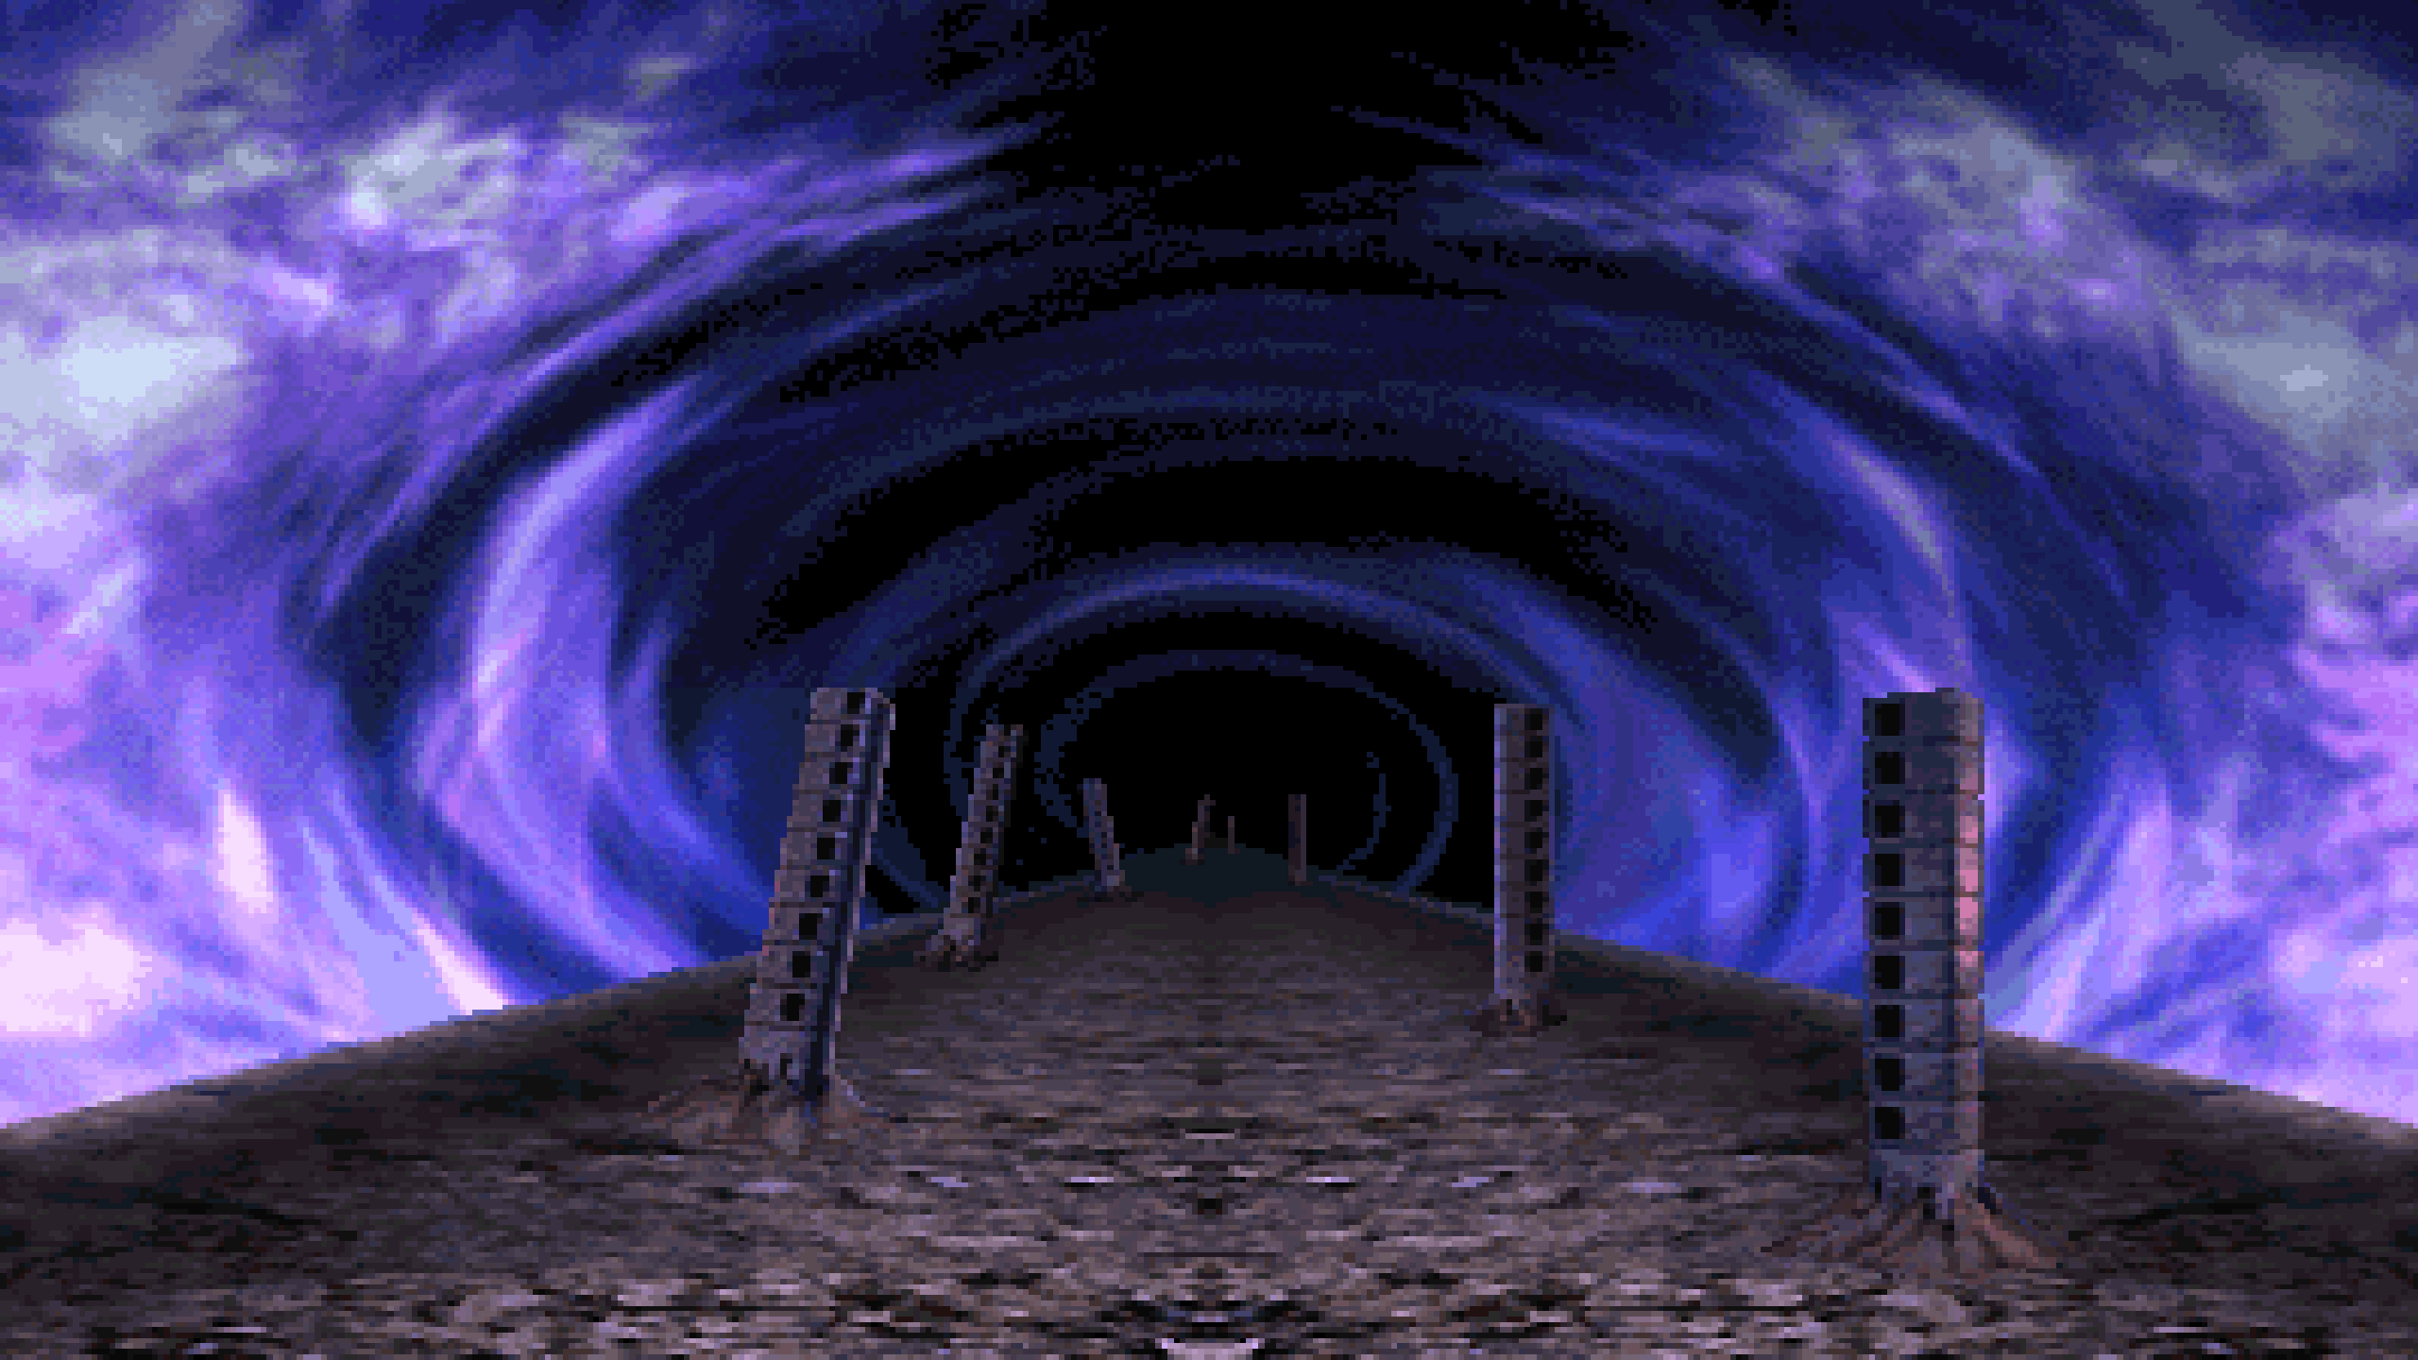
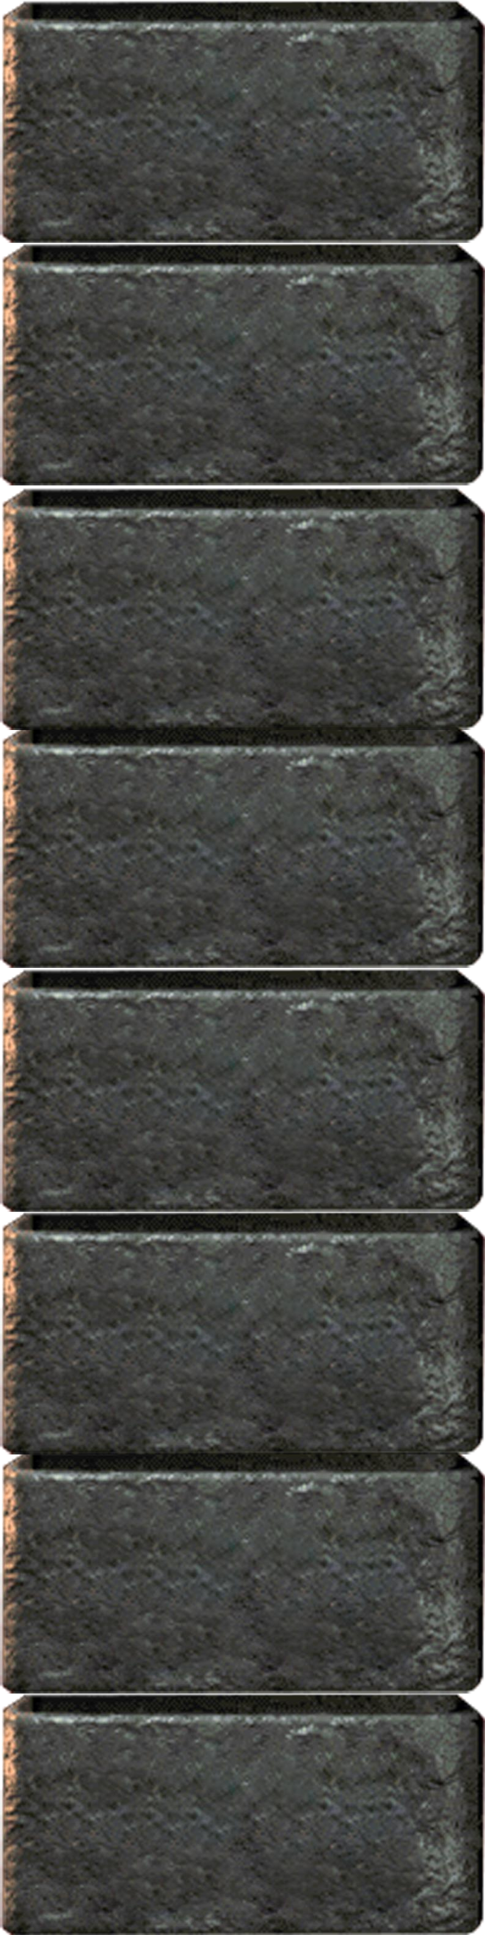





Class Topics
Class Topics
Time Complexity
Advanced Topics
Reducibility
Decidability
The Church- Turing Thesis
Context-Free Languages
Regular Languages
Background Knowledge

Slide 2
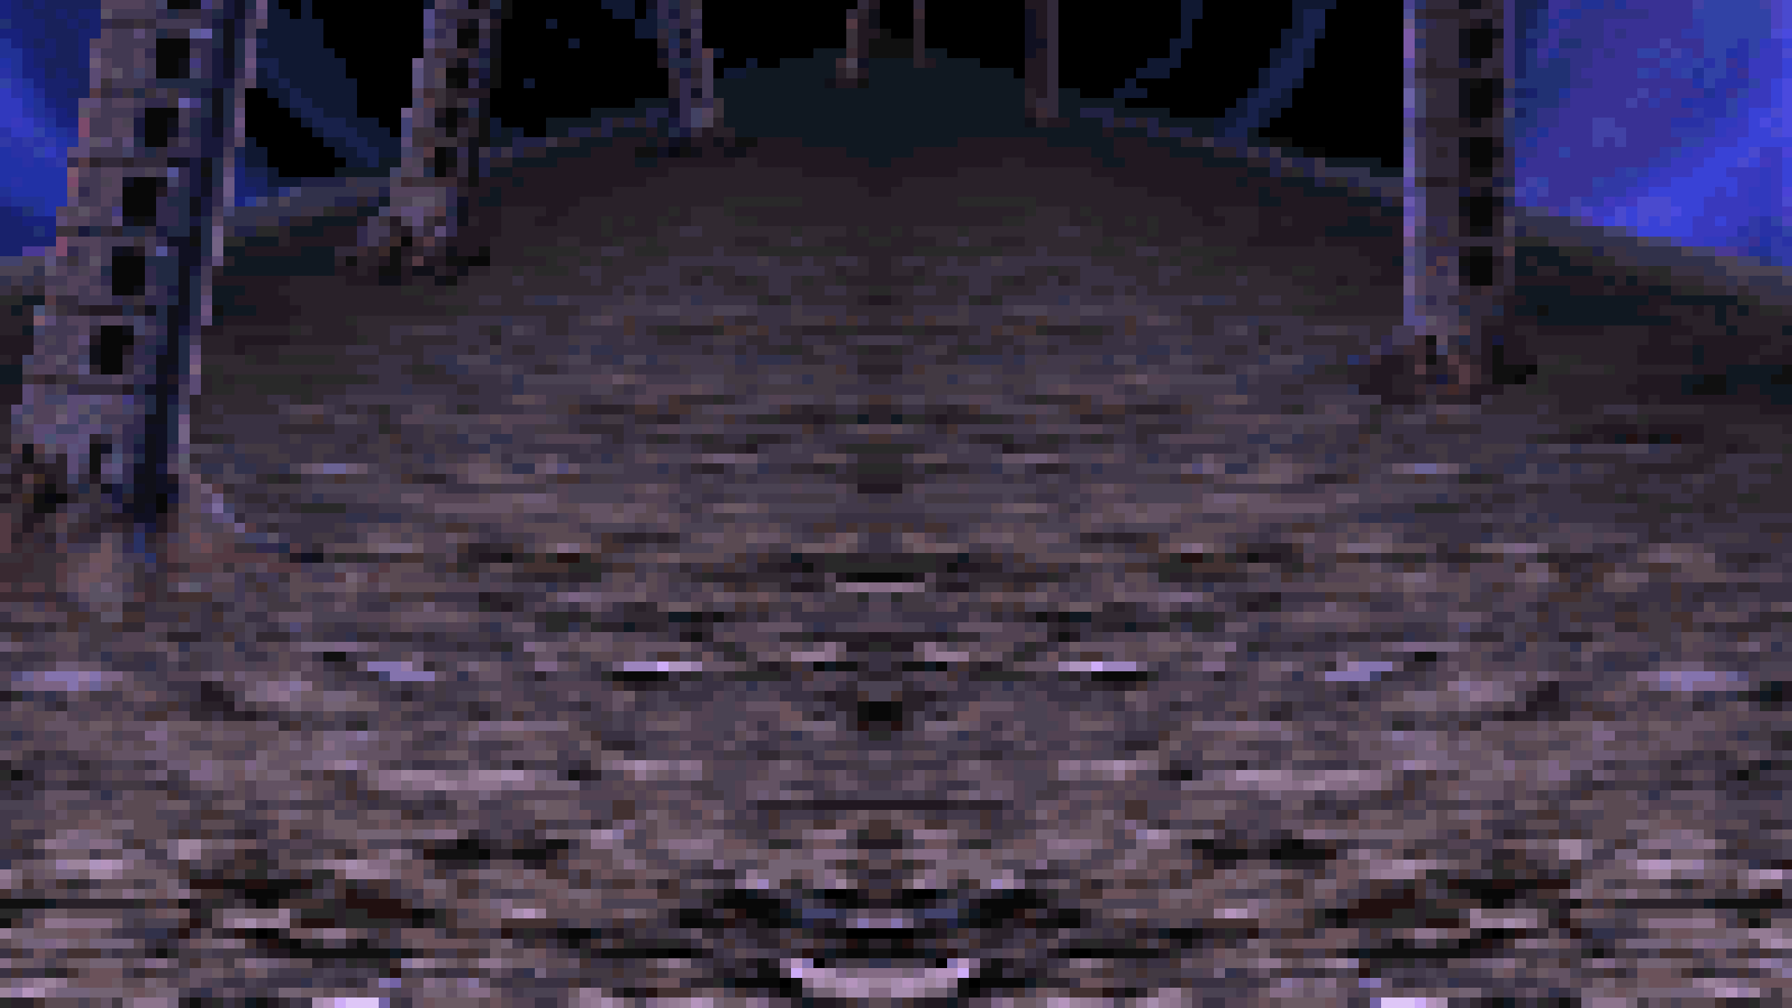
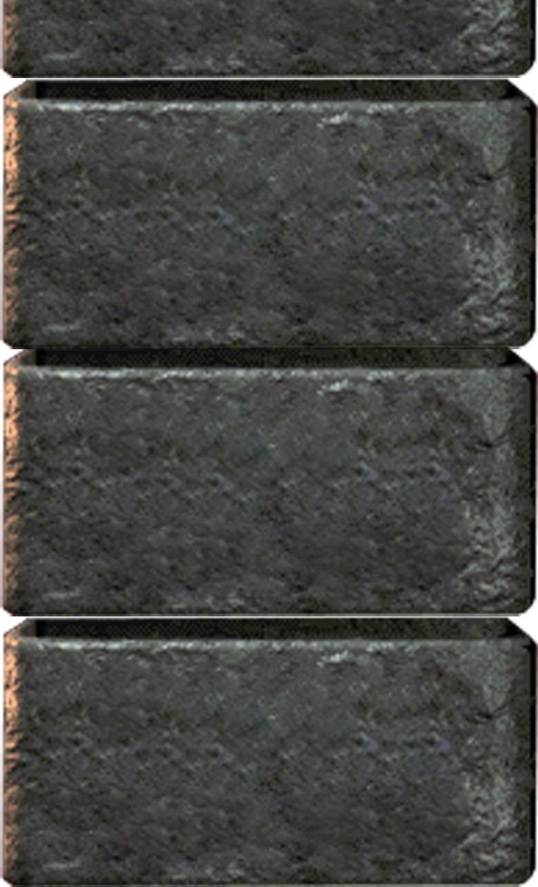






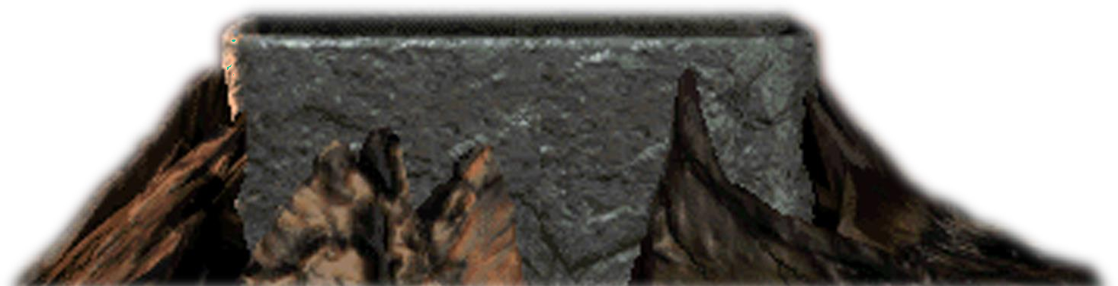
Context-Free Languages
Class Topics
Regular Languages
Background Knowledge

Slide 3





Context-Free Languages
Class Topics
Finite Automata Nondeterminism Regular Expressions Nonregular Languages
Regular Languages
5 Classes
Background Knowledge

Slide 4
Introduction
Our goal in this first part of the course is to understand what computers can do
But today’s computers are complex objects, and it is hard to talk about
them mathematically.
We will see abstract models of computers that are much simpler But capture the important aspects of computers in general
We will look a several models that vary in their capabilities and the way they approximate to computers we deal everyday.
To start, we will look at a very simple model called finite automaton. It represents a simple computer that has a very small amount of memory.
We will look at the capabilities of this kind of machines.

Slide 5
Motivation Problem
Door
Front Pad
Rear Pad

Slide 6
Door
Front Pad
Rear Pad

Slide 7
Door
Front Pad
Rear Pad

Slide 8
Door
Front Pad
Rear Pad

Slide 9
Door
Front Pad
Rear Pad

Slide 10
Door
Front Pad
Rear Pad

Slide 11
Door
Front Pad
Rear Pad

Slide 12
Door
Front Pad
Rear Pad

Slide 13
Door
Front Pad
Rear Pad

Slide 14


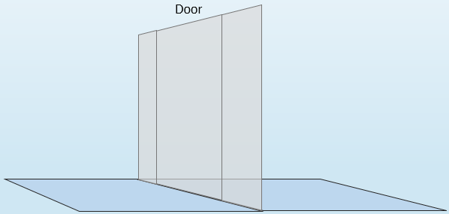
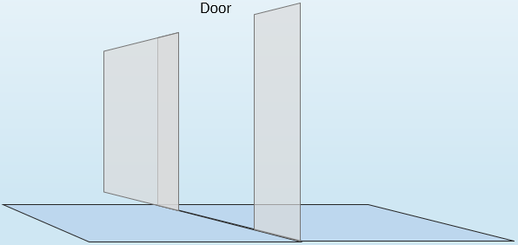
What are the possible states of the door?
Closed
Open
Closed
Open

Slide 15


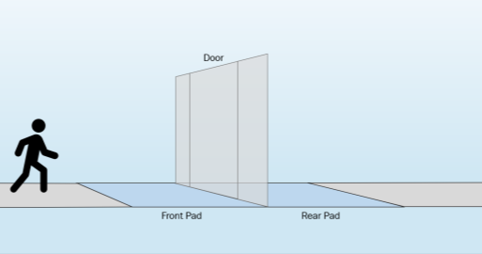
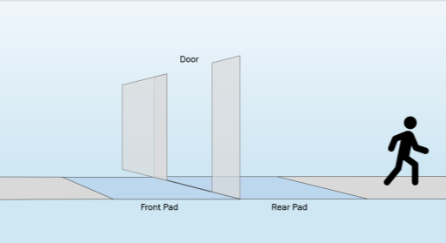


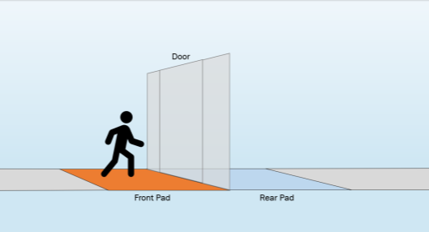
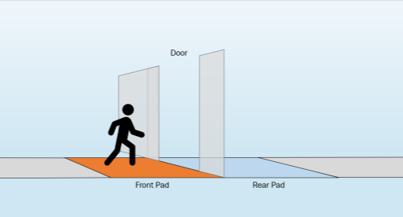

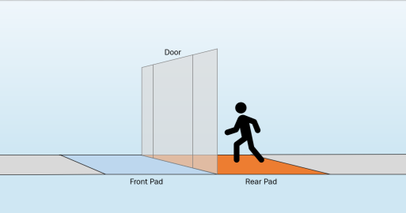
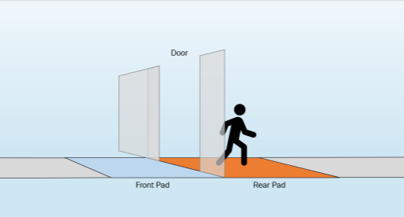


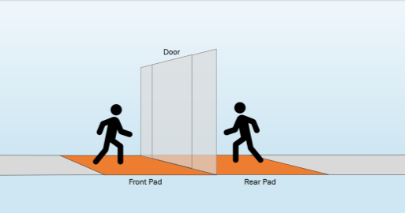
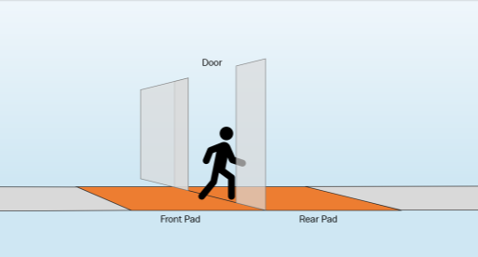
What are the possible transitions for the door?
When door is Closed
When door is Open
Neither
Neither
Both
Both
Rear
Rear
Front
Front
Neither
Front
Front
Rear
Rear
Closed
Open
Both
Both
Neither
Simplified version of an DFA

Slide 16







What are the possible transitions for the door?
Both
Both
Neither
Neither
Rear
Rear
Neither
Front
Front
Front
Front
Closed
Open
Rear
Rear
Neither
The door controller is an example of a simple finite automaton.
With just a single bit it is capable to record which state it is in.
Both
Both

Slide 17
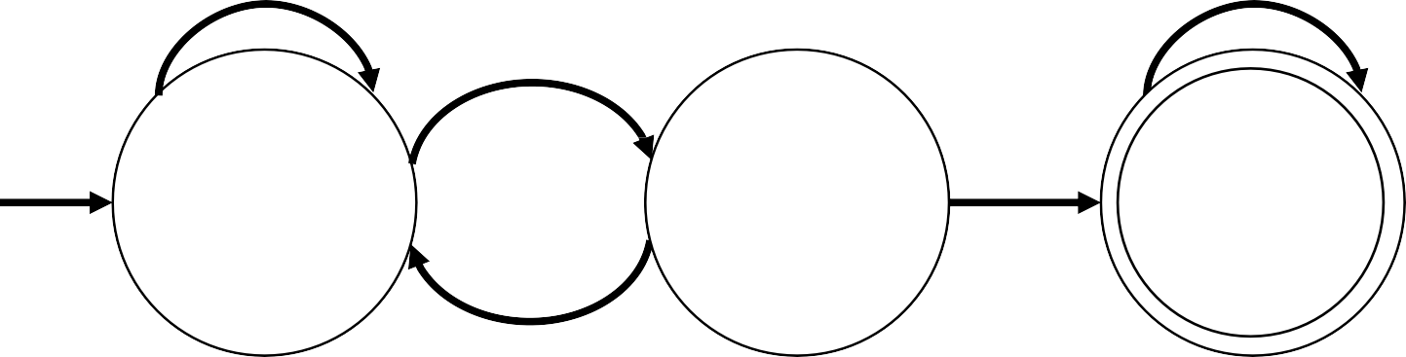
Deterministic Finite Automata (DFA)
Is the simplest model of computation
Accept or reject strings of characters by parsing them through a sequence that is uniquely determined by each string.
“Deterministic” refers to the fact that each state sequence is unique.
“Finite” because there are a limited number of possible states which can be reached.
𝑀₁
0
0,1
1
1
𝑞₁
𝑞₂
𝑞₃
0

Slide 18

Deterministic Finite Automata (DFA)
0
0,1
𝑀₁
1
1
𝑞₁
𝑞₂
𝑞₃
0
States:
𝑞1, 𝑞2, 𝑞3
1
Input: Finite string
Output: Accept or Reject
Transitions:
Start State:
Alphabet: Σ = {0,1}
The symbols we can use in the transitions
Accept States:

Slide 19
Deterministic Finite Automata (DFA)
0
0,1
𝑀₁
1
1
𝑞₁
𝑞₂
𝑞₃
0
Example:
Computation Process:
Begin at start state
Read input symbols
Follow corresponding transitions
Input: 01101
•
Accept if end with accept state, reject if not

Slide 20
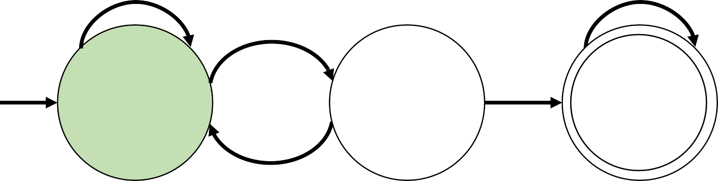
Deterministic Finite Automata (DFA)
0
0,1
𝑀₁
1
1
𝑞₁
𝑞₂
𝑞₃
0
Example:
Computation Process:
Begin at start state
Read input symbols
Follow corresponding transitions
Input: 01101
Start in state 𝑞₁
•
Accept if end with accept state, reject if not

Slide 21
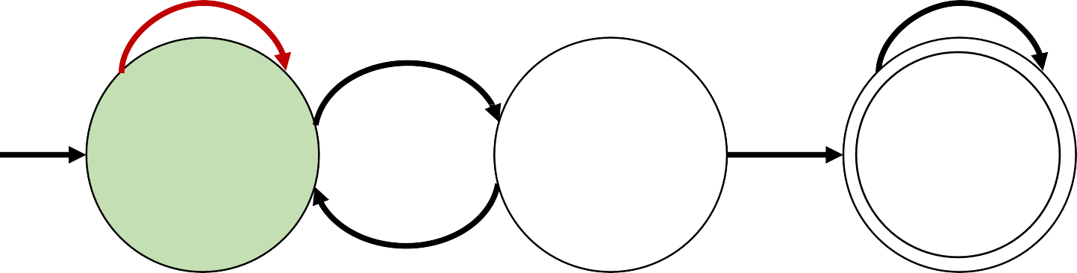
Deterministic Finite Automata (DFA)
0
0,1
𝑀₁
1
1
𝑞₁
𝑞₂
𝑞₃
0
Example:
Computation Process:
Begin at start state
Read input symbols
Follow corresponding transitions
Input: 01101
Read 0, follow transition from
𝑞₁ to 𝑞₁
•
Accept if end with accept state, reject if not

Slide 22
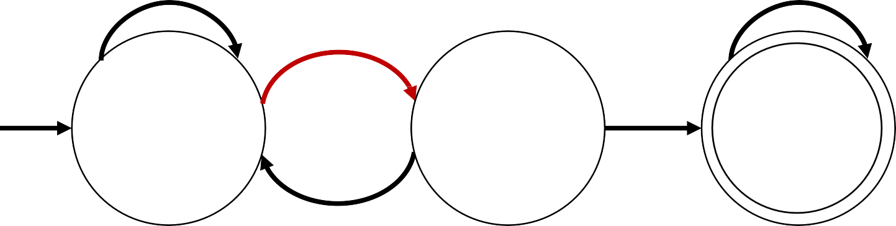
Deterministic Finite Automata (DFA)
0
0,1
𝑀₁
1
1
𝑞₁
𝑞₂
𝑞₃
0
Computation Process:
Begin at start state
Example:
Input: 01101
•
•
•
Read input symbols
Follow corresponding transitions
Accept if end with accept state, reject if not
Read 1, follow transition from
𝑞₁ to 𝑞₂

Slide 23
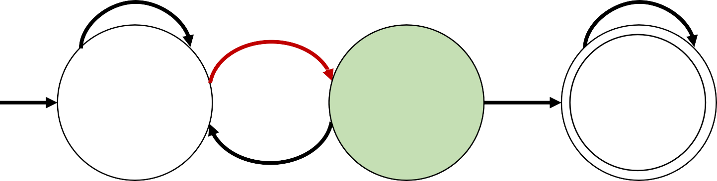
Deterministic Finite Automata (DFA)
0
0,1
𝑀₁
1
1
𝑞₁
𝑞₂
𝑞₃
0
Computation Process:
Begin at start state
Example:
Input: 01101
•
•
•
Read input symbols
Follow corresponding transitions
Accept if end with accept state, reject if not
Read 1, follow transition from
𝑞₁ to 𝑞₂

Slide 24
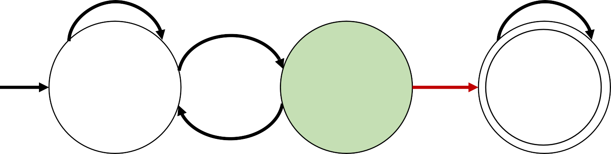
Deterministic Finite Automata (DFA)
0
0,1
𝑀₁
1
1
𝑞₁
𝑞₂
𝑞₃
0
Example:
Computation Process:
Begin at start state
Read input symbols
Follow corresponding transitions
Accept if end with accept state, reject if not
Input: 01101
Read 1, follow transition from
𝑞₂ to 𝑞₃

Slide 25
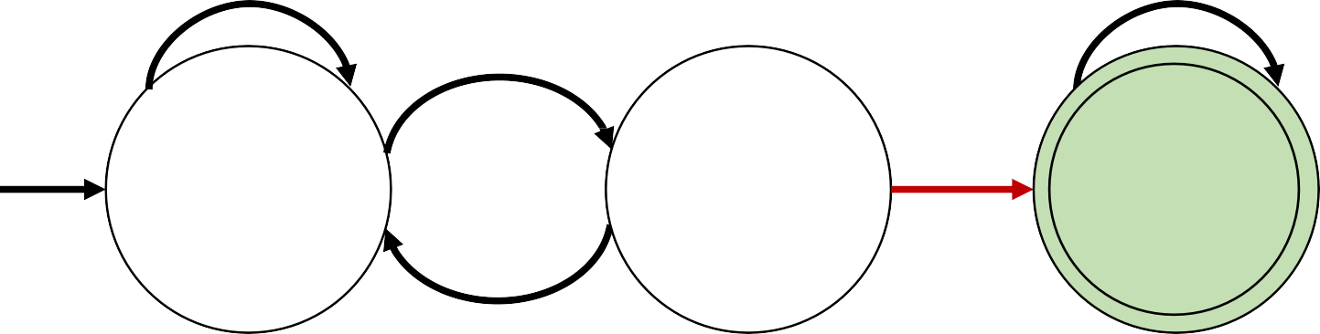
Deterministic Finite Automata (DFA)
0
0,1
𝑀₁
1
1
𝑞₁
𝑞₂
𝑞₃
0
Example:
Computation Process:
Begin at start state
Read input symbols
Follow corresponding transitions
Input: 01101
Read 1, follow transition from
•
Accept if end with accept state, reject if not

Slide 26
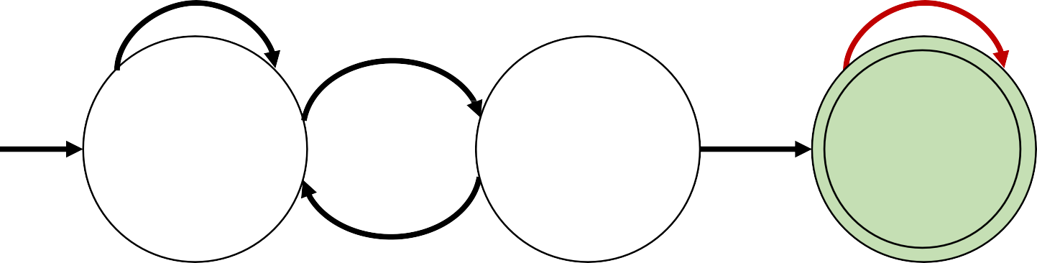
Deterministic Finite Automata (DFA)
0
0,1
𝑀₁
1
1
𝑞₁
𝑞₂
𝑞₃
0
Example:
Computation Process:
Begin at start state
Read input symbols
Follow corresponding transitions
Input: 01101
Read 0, follow transition from
•
Accept if end with accept state, reject if not

Slide 27
Deterministic Finite Automata (DFA)
0
0,1
𝑀₁
1
1
𝑞₁
𝑞₂
𝑞₃
0
Computation Process:
Begin at start state
Example:
Input: 01101
•
•
•
Read input symbols
Follow corresponding transitions
Accept if end with accept state, reject if not
Read 1, follow transition from
𝑞₃ to 𝑞₃

Slide 28
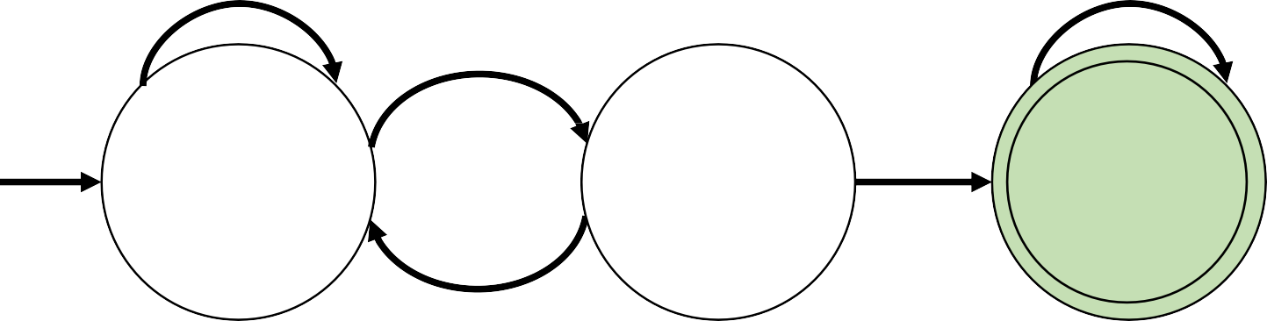
Deterministic Finite Automata (DFA)
0
0,1
𝑀₁
1
1
𝑞₁
𝑞₂
𝑞₃
0
Example:
Computation Process:
Begin at start state
Read input symbols
Follow corresponding transitions
Accept if end with accept state, reject if not
Input: 01101
Output: Accept
Accept because 𝑀₁ is in an accept
state 𝑞₃ at the end of the input.

Slide 29
Deterministic Finite Automata (DFA)
0
0,1
𝑀₁
1
1
𝑞₁
𝑞₂
𝑞₃
0
Computation Process:
Does 𝑀₁ accept the following string?
Begin at start state
Read input symbols
Follow corresponding transitions
Accept if end with accept state, reject if not
Input: 00101
Output:

Slide 30
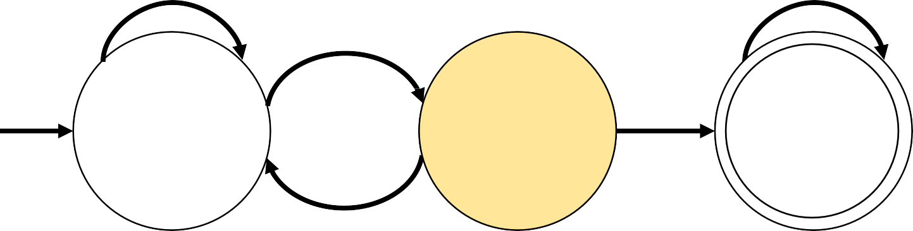
Deterministic Finite Automata (DFA)
0
0,1
𝑀₁
1
1
𝑞₁
𝑞₂
𝑞₃
0
Computation Process:
Does 𝑀₁ accept the following string?
Begin at start state
Read input symbols
Follow corresponding transitions
Accept if end with accept state, reject if not
Input: 00101
Output: Reject
𝑀₁ stops at 𝑞₂ state that is not an accept state.

Slide 31
Deterministic Finite Automata (DFA)
0
0,1
𝑀₁
1
1
𝑞₁
𝑞₂
𝑞₃
0
What are the set of strings that 𝑀₁ accepts?
𝑀₁ accepts exactly those strings in 𝐴 where:
𝐴 = {𝑤|𝑤 contains substring 11}
The set of strings that the strings contains the substring 11

Slide 32
Deterministic Finite Automata (DFA)
0
0,1
𝑀₁
1
1
𝑞₁
𝑞₂
𝑞₃
0
What are the set of strings that 𝑀₁ accepts?
𝑀₁ accepts exactly those strings in 𝐴 where: 𝐴 = {𝑤|𝑤 contains substring 11}
𝐴 is the language of 𝑀₁
𝑀₁ recognizes 𝐴
𝐴 = 𝐿(𝑀₁)

Slide 33

DFA – Strings and Languages
A string is a finite sequence of symbols in 𝛴
Example:
𝛴 = {0,1} 𝑤 = 0100101110001
Empty string = 𝜀 (epsilon)
A DFA that the accept state is the start state accepts 𝜀
𝑞₀
Sequence of zero symbols
A language is a set of strings (finite or infinite)
𝐿₁ = {01,10,110,011} 𝐿₂ = {𝜀, 00,01,10,11,001,010,011,100, … }
𝐿₃ = {}
Example:
Empty language: set of zero strings
Accept state not reachable
𝑞₀

Slide 34
DFA– Accepting strings
Def: 𝑀 accepts string 𝑤 = 𝑤₁𝑤₂𝑤₃ … 𝑤_{𝑛} each 𝑤_{𝑖} ∈ 𝛴 if there is a sequence of states 𝑟₀, 𝑟₁, 𝑟₂, … , 𝑟_{𝑛} ∈ 𝑄 where:
𝑟₀ = 𝑞₀
Starts at the start state
𝑟_{𝑖+1} = 𝛿(𝑟_{𝑖}, 𝑤_{𝑖+1}) for 0 ≤ 𝑖 ≤ 𝑛
Each state legally follows the transition state accordingly with the transition function
𝑟_{𝑛} ∈ 𝐹
The end of the input needs to be in an accept state

Slide 35
DFA– Recognizing Languages
Def: 𝑀 accepts string 𝑤 = 𝑤₁𝑤₂𝑤₃ … 𝑤_{𝑛} each 𝑤_{𝑖} ∈ 𝛴 if there is a sequence of states 𝑟₀, 𝑟₁, 𝑟₂, … , 𝑟_{𝑛} ∈ 𝑄 where:
𝑟₀ = 𝑞₀
Starts at the start state
𝑟_{𝑖+1} = 𝛿(𝑟_{𝑖}, 𝑤_{𝑖+1}) for 0 ≤ 𝑖 ≤ 𝑛
Each state legally follows the transition state accordingly
with the transition function
𝑟_{𝑛} ∈ 𝐹
The end of the input needs to be in an accept state
Recognizing Languages:
𝐿 𝑀 = {𝑤|𝑀 𝑎𝑐𝑐𝑒𝑝𝑡𝑠 𝑤}
𝐿 𝑀 is the language of 𝑀 𝑀 recognizes 𝐿(𝑀)
Every DFA might accept many strings, but it always recognizes one particular language.

Slide 36
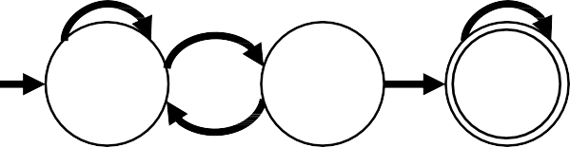
DFA– Recognizing Languages
Recognizing Languages:
𝐿 𝑀 = {𝑤|𝑀 𝑎𝑐𝑐𝑒𝑝𝑡𝑠 𝑤}
𝐿 𝑀 is the language of 𝑀 𝑀 recognizes 𝐿(𝑀)
Every DFA might accept many strings, but it always recognizes one particular language.
Def: A language is regular if some finite automaton recognizes it.
0
0,1
𝑀₁
1
1
𝐿 𝑀
= 𝑤 𝑤 contains substring 11 = 𝐴
𝑞₁
𝑞₂
𝑞₃
1
0
𝐴 is a regular language

Slide 37

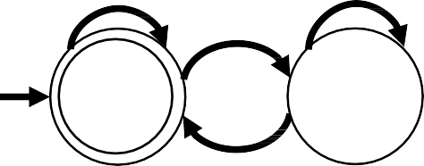
DFA– Recognizing Languages
Def: A language is regular if some finite automaton recognizes it.
0
0,1
𝑀₁
1
𝐿 𝑀
= 𝑤 𝑤 contains substring 11 = 𝐴
1
1
𝑞₁
𝑞₂
𝑞₃
𝐴 is a regular language
0
Is 𝐵 a regular language?
Let 𝐵 = {𝑤|𝑤 has an even number of 1𝑠}
𝛴 = {0,1}
Set of strings that contain an even number of 1s
0
0
1
𝐵 is regular
We need to build the automaton that recognizes 𝐵
𝑀₂
𝑞₁
𝑞₂
Test with different combinations of
strings e.g. 0110,001,101,00110, …
1

Slide 38
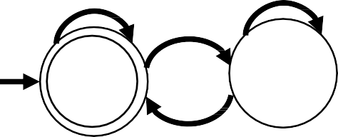
DFA– Recognizing Languages
Let 𝐵 = {𝑤|𝑤 has an even number of 1𝑠}
𝛴 = {0,1}
The strings that contain an even number of 1s
0
0
1
𝐵 is regular
We need to build the automaton that recognizes 𝐵
𝑀₂
𝑞₁
𝑞₂
1
Let 𝐶 = {𝑤|𝑤 has an equal number of 0s and 1𝑠}
𝐶 is not regular
There is no way to build an automaton that recognizes this language.
We will see why further in the course!
In general: Not regular languages is anything that requires memory.
DFAs cannot store strings DFAs cannot count

Slide 39
DFA – Formal Definition
Def: A finite automaton 𝑀 is a 5-tuple (𝑄, 𝛴, 𝛿, 𝑞₀, 𝐹)
A list of 5 components
𝑀 = (𝑄, 𝛴, 𝛿, 𝑞₀, 𝐹)
𝑄: finite set of states
𝛴: alphabet, finite set symbols
𝛿: transition function
𝛿: 𝑄 × 𝛴 → 𝑄
𝑞₀: start state
𝐹: set of ACCEPT states
𝛿 𝑞, 𝑎 = 𝑟
𝐹 ⊆ 𝑄
a
Can have more than 1 accept state
𝑞 𝑟

Slide 40
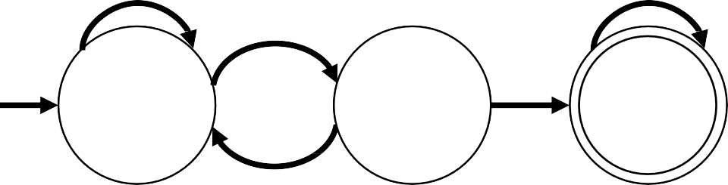
DFA – Formal Definition
𝑀 = (𝑄, 𝛴, 𝛿, 𝑞₀, 𝐹)
𝑄: finite set of states
𝛴: alphabet, finite set symbols
𝛿: transition function 𝛿: 𝑄 × 𝛴 → 𝑄
𝑞₀: start state
𝐹: set of ACCEPT states
Example:
0
0,1
𝑀₁
1
1
𝑞₁
𝑞₂
𝑞₃
0
𝑀₁ = (𝑄, 𝛴, 𝛿, 𝑞₀, 𝐹)
𝑄 = {𝑞₁, 𝑞₂, 𝑞₃}
𝛴 = {0,1}
𝛿 =
𝑞₀ = 𝑞₁
𝐹 = {𝑞₃}
 | 0 | 1
𝒒_{𝟏} | 𝑞₁ | 𝑞₂
𝒒_{𝟐} | 𝑞₁ | 𝑞₃
𝒒_{𝟑} | 𝑞₃ | 𝑞₃

Slide 41
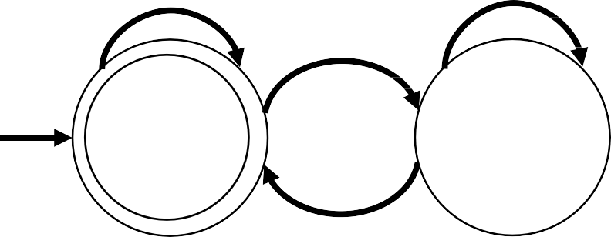
DFA – Formal Definition
Example 2:
0
𝑀₂ = (𝑄, 𝛴, 𝛿, 𝑞₀, 𝐹)
𝑀₂
0
1
𝑄 = {𝑞₁, 𝑞₂}
𝛴 = {0,1}
𝑞₀ = 𝑞₁
𝐹 = {𝑞₁}
𝑞₁
𝑞₂
1
𝛿 =
 | 0 | 1
𝒒_{𝟏} | 𝑞₁ | 𝑞₂
𝒒_{𝟐} | 𝑞₂ | 𝑞₁
𝐵 = {𝑤|𝑤 has an even number of 1𝑠}
𝑀₂ recognizes 𝐵(𝑀₂)
𝐵 is regular

Slide 42
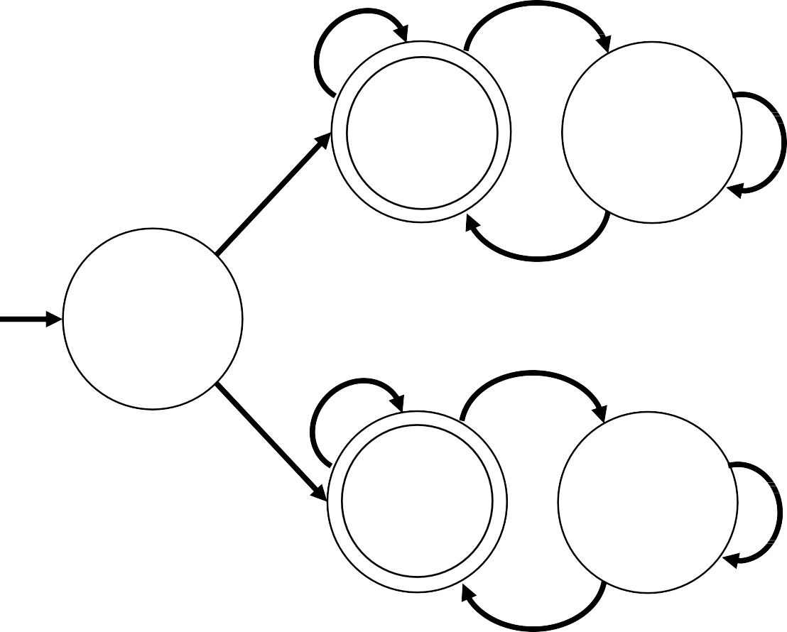
DFA – Formal Definition
Example 3:
𝑀₃ = (𝑄, 𝛴, 𝛿, 𝑞₀, 𝐹)
𝑏
𝑀₃
𝑎
𝑄 = {𝑠, 𝑞₁, 𝑞₂, 𝑟₁, 𝑟₂}
𝛿 =
 | 𝑎 | 𝑏
𝒔 | 𝑞₁ | 𝑟₁
𝒒_{𝟏} | 𝑞₁ | 𝑞₂
𝒒_{𝟐} | 𝑞₁ | 𝑞₂
𝒓_{𝟏} | 𝑟₂ | 𝑟₁
𝒓_{𝟐} | 𝑟₂ | 𝑟₁
𝛴 = {𝑎, 𝑏}
𝑞₀ = 𝑠
𝐹 = {𝑞₁, 𝑟₁}
𝑞₁
𝑞₂
𝑏
𝑎
𝑎
𝑠
𝑎
𝑏
What are the strings that 𝑀₃ accepts?
𝑏
𝑤₁ = 𝑎
𝑤₂ = 𝑏
𝑤₄ = 𝑎𝑏𝑏𝑎
𝑤₅ = 𝑏𝑏𝑏𝑎
𝑟₁
𝑟₂
𝑎
𝑤₃ = 𝑎𝑏
𝑤₆ = 𝑏𝑏𝑎𝑏
𝑏

Slide 43
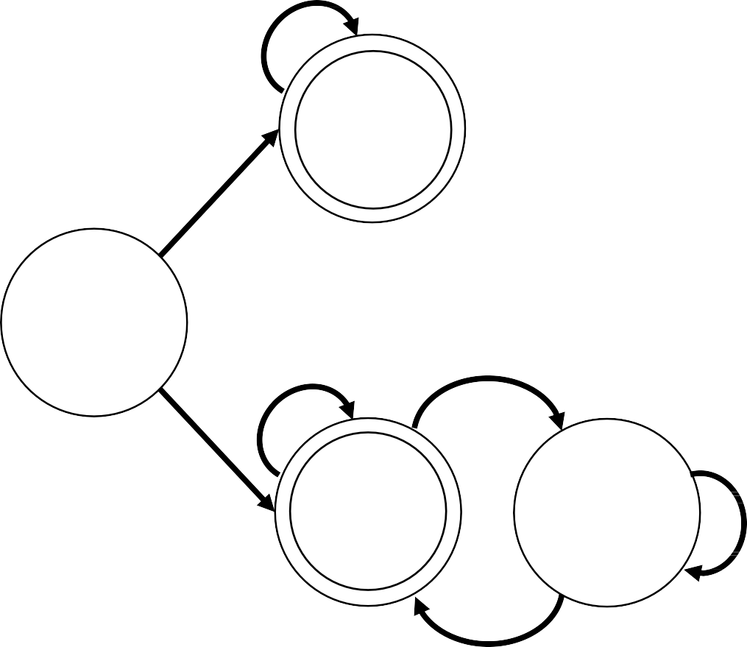
DFA – Formal Definition
Example 3:
𝑀₃ = (𝑄, 𝛴, 𝛿, 𝑞₀, 𝐹)
𝑏
𝑀₃
𝑎
𝑄 = {𝑠, 𝑞₁, 𝑞₂, 𝑟₁, 𝑟₂}
𝛿 =
 | 𝑎 | 𝑏
𝒔 | 𝑞₁ | 𝑟₁
𝒒_{𝟏} | 𝑞₁ | 𝑞₂
𝒒_{𝟐} | 𝑞₁ | 𝑞₂
𝒓_{𝟏} | 𝑟₂ | 𝑟₁
𝒓_{𝟐} | 𝑟₂ | 𝑟₁
𝛴 = {𝑎, 𝑏}
𝑞₀ = 𝑠
𝐹 = {𝑞₁, 𝑟₁}
𝑞₁
𝑞₂
𝑏
𝑎
𝑎
𝑠
𝑎
𝑏
What is the language that 𝑀₃ recognizes?
𝑏
𝑎
𝐶 = {𝑤|𝑤 𝑠𝑡𝑎𝑟𝑡𝑠 𝑎𝑛𝑑 𝑒𝑛𝑑𝑠 𝑤𝑖𝑡ℎ
𝑡ℎ𝑒 𝑠𝑎𝑚𝑒 𝑠𝑦𝑚𝑏𝑜𝑙}
𝑟₁
𝑟₂
𝑀₃ recognizes 𝐶(𝑀₃)
𝐶 is regular
𝑏

Slide 44
DFA – Design
Suppose that you are given some language and want to design a finite automaton that recognizes it.
How would you go about performing the machine’s task?
Put yourself in the place of the machine you are trying to design.
You receive an input string and must determine whether it is a member of the language the
automaton is supposed to recognize.
You get to see the symbols in the string one by one and must decide whether the
string seen so far is in the language.
The machine doesn’t know when the end of the string is
coming, so you must always be ready with the answer.
Figure out what you need to remember about the string as you are reading it
DFA has finite number of states, which means finite memory.

Slide 45
DFA – Design
Suppose that you are given some language and want to design a finite automaton that recognizes it.
How would you go about performing the machine’s task?
Example:
𝛴 = {0,1} 𝐿 = {𝑤|𝑤 has odd number of 1𝑠}
Do you need to remember the entire string seen so far in order to determine whether the number of 1s is odd?
No, simply remember whether the number of 1s seen so far is even or odd and keep track of this information as you read new symbols. If you read a 1, flip the answer; but if you read a 0, leave the answer as is.

Slide 46
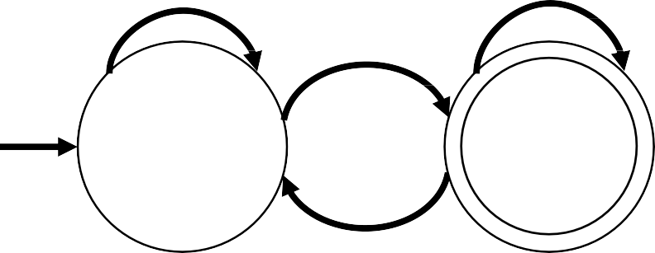
DFA – Design
Suppose that you are given some language and want to design a finite automaton that recognizes it.
How would you go about performing the machine’s task?
Example:
𝛴 = {0,1} 𝐿 = {𝑤|𝑤 has odd number of 1𝑠}
0
0
𝐸₁
1
^{𝑞}𝑒𝑣𝑒𝑛
^{𝑞}𝑜𝑑𝑑
1

Slide 47
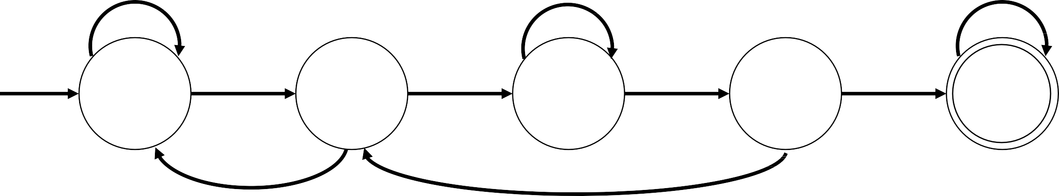
DFA – Design Example
Construct a DFA that accepts any string that does not contain 0011 in it.
Approach: Try a simpler problem. DFA that accepts strings that contain 0011.
𝐶 = {𝑤|𝑤 contains 0011} 𝛴 = {0,1}
𝐸₂ recognizes 𝐶(𝐸₂)
𝐸₂
1
0
0,1
0
0
1
1
𝑞₁
𝑞₂
𝑞₃
𝑞₄
𝑞₅
1
0

Slide 48

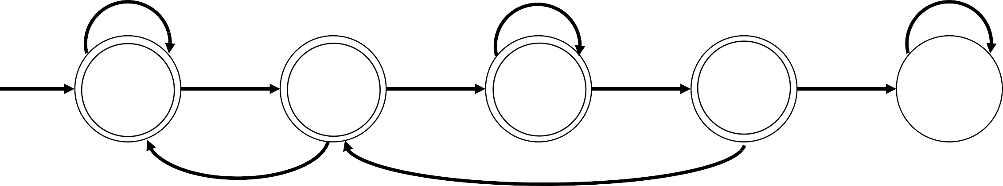
DFA – Design Example
𝐸₂
1
0
0,1
0
0
1
1
𝑞₁
𝑞₂
𝑞₃
𝑞₄
𝑞₅
1
0
0
𝐸₃
0,1
1
0
0
1
1
𝑞₁
𝑞₂
𝑞₃
𝑞₄
𝑞₅
1
0

Slide 49
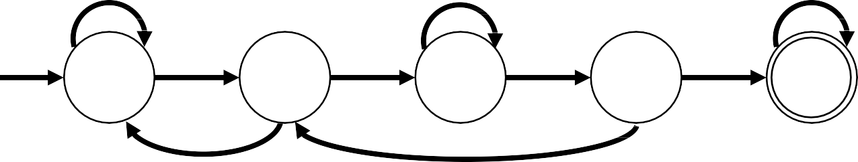
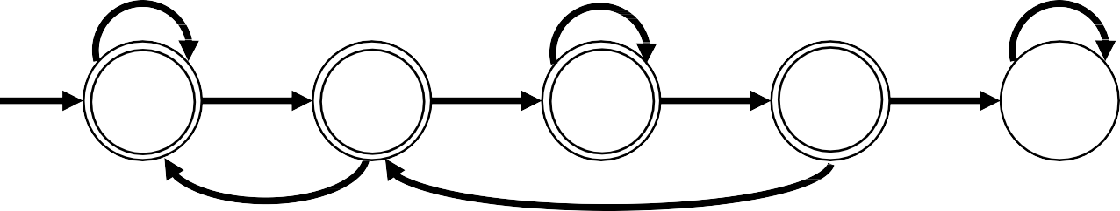
DFA – Design Example
𝐸₂
1
0
0,1
0
0
1
1
𝑞₁
𝑞₂
𝑞₃
𝑞₄
𝑞₅
1
𝐿 𝐸₂ = 𝐿(𝐸₃)
0
𝐸₃
0,1
1
0
The language of 𝐸₂ is the complement of 𝐸₃
0
0
1
1
𝑞₁
𝑞₂
𝑞₃
𝑞₄
𝑞₅
1
0
Set complements is always relative to some “Universe”
The “Universe”: All possible strings made with symbols from the alphabet
𝛴 = {0,1} 𝑈𝑛𝑖𝑣𝑒𝑟𝑠𝑒 = 0,1 ∗

Slide 50

DFA – Design Example
𝐸₃
0,1
1
0
0
0
1
1
𝑞₁
𝑞₂
𝑞₃
𝑞₄
𝑞₅
1
0
𝐷 = {𝑤|𝑤 does not contain 0011}
𝐸₃ recognizes 𝐷(𝐸₃)

Slide 51

Wrap-up
Introduction and motivation of Deterministic Finite Automata (DFA)
DFA computation process
Accepting/Rejecting strings
Recognizing languages
Definition of DFAs
Languages basics

Slide 52
Next Class
Regular expressions
Regular operations
Prove class of regular languages is closed under union
Start Closure under concatenation

